Slide 1
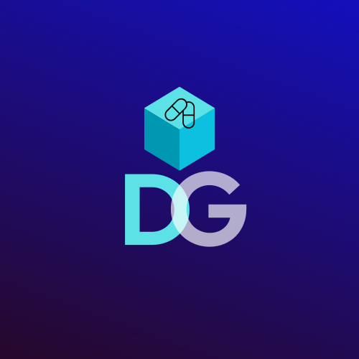
Drug Guardian "Securing Every Dose: Blockchain-Driven Drug Supply Chain to Combat Counterfeit"
Team Members : Tanishka Das
Pallavi Dhandar
Jatush Hingu
Akash Nadar
Guided By: Ms. Brinal Colaco
Department Of Computer Engineering
Notes:
Scenario: Imagine a fast-growing tech company, "TechNova Solutions", that aims to increase diversity and improve mentorship programs for its workforce. Despite implementing mentorship initiatives, the company faces challenges in connecting women employees with suitable mentors, especially those from different cultural, linguistic, or professional backgrounds. Additionally, employees with speech or hearing impairments struggle to participate effectively in mentorship sessions.
To address these issues, TechNova Solutions adopts EmpowerHer, a comprehensive mentorship platform designed to create impactful connections through AI-powered guidance, personalized support, and inclusive features.
Why EmpowerHer: TechNova Solutions faces a talent development gap where women employees struggle to find relevant mentors and guidance. EmpowerHer offers a personalized mentorship platform with secure login, profile management, and career-focused recommendations. Its modern UI ensures ease of use for all employees, making mentorship more accessible and impactful.

Slide 2
Problem Statement
🔹 The pharmaceutical industry loses $200B annually due to counterfeit drugs.
🔹 Traditional supply chains lack transparency and traceability, increasing fraud risks.
🔹 Regulatory bodies (DSCSA, FMD) demand stricter compliance, making audits complex.
🔹 Outdated paper-based systems cause inefficiencies and errors in tracking.

Slide 3
Solution – Drug Guardian
This is a Blockchain-based system for pharmaceutical supply chain Integrity provides a secure, transparent, and scalable platform for tracking pharmaceuticals. Its modular architecture ensures easy maintenance and expansion. By securely recording every transaction, the system enhances trust and accountability in the supply chain.
🔹 End-to-End Drug Traceability → Track every movement in real-time.
🔹 Smart Contract Automation → Enforce secure and error-free transactions.
🔹 Counterfeit Prevention → Ensure only genuine drugs enter the supply chain.
🔹 Regulatory Compliance → Fully aligned with DSCSA, FMD, and WHO standards.
🔹 Consumer Drug Verification → Verify authenticity via a simple QR scan.

Slide 4
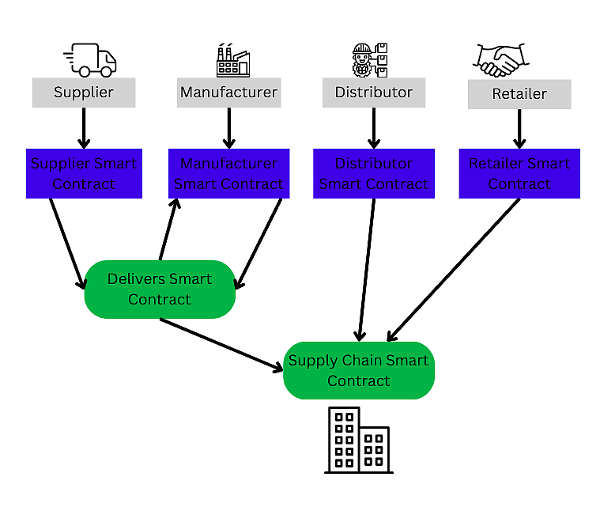
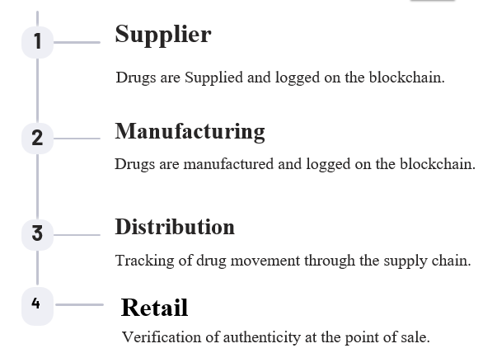
Proposed system
A decentralized, tamper-proof ledger that tracks every drug transaction from raw materials to the end consumer, ensuring authenticity, security, and compliance.

Slide 5
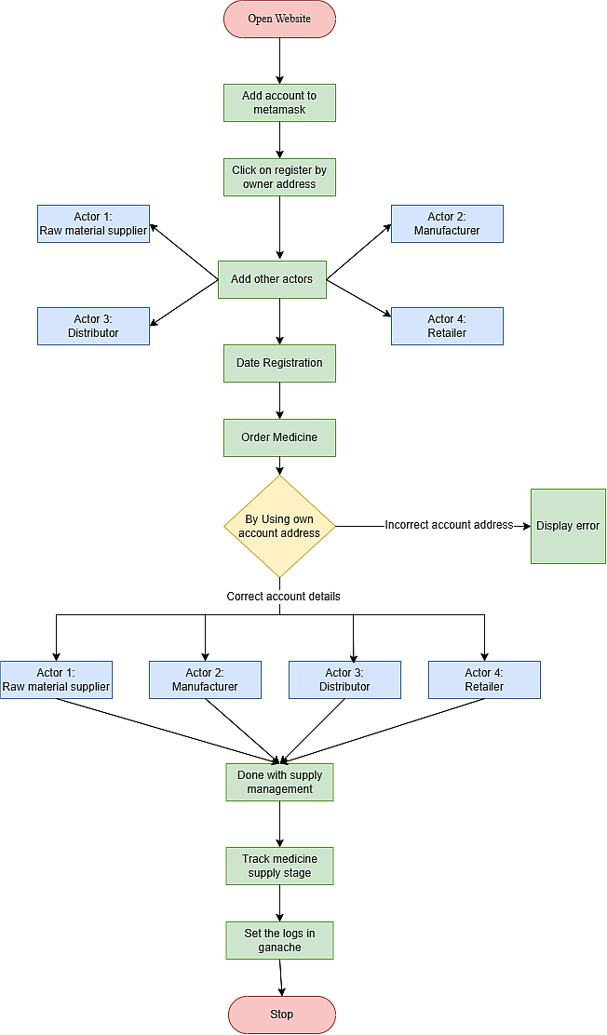
Process Diagram of the Site

Slide 6
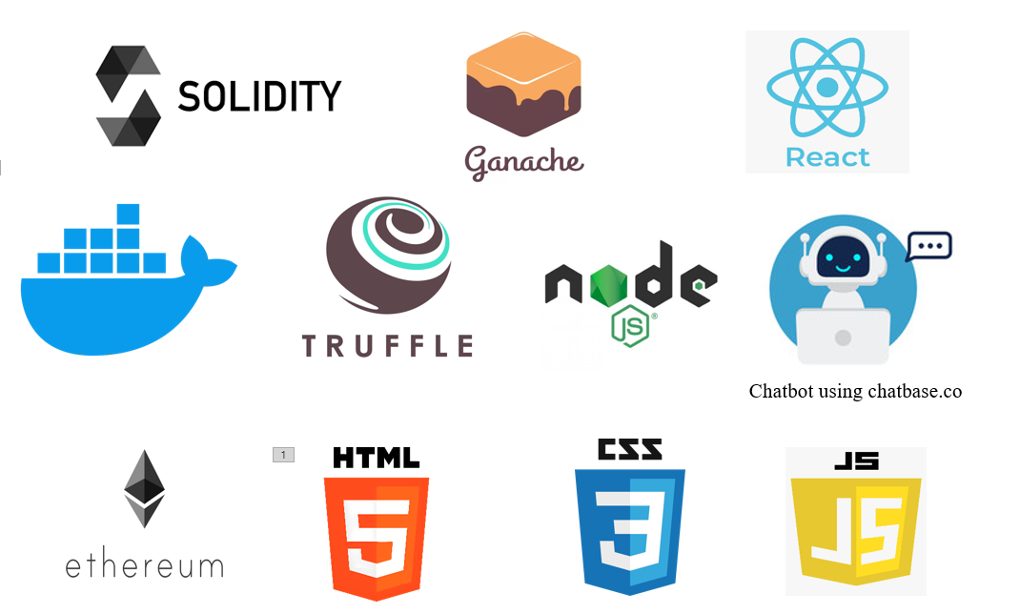
Tech Stack

Slide 7
Benefits
1️⃣ Enhanced Transparency & Traceability
2️⃣ Counterfeit Prevention & Fraud Reduction
3️⃣ Regulatory Compliance & Audit Readiness
4️⃣ Improved Operational Efficiency & Cost Savings
5️⃣ Consumer Trust & Safety
Notes:
1️⃣ Enhanced Transparency & Traceability
Real-time tracking of drugs from raw materials to the end consumer. Immutable blockchain ledger prevents data manipulation. Stakeholders (manufacturers, distributors, regulators) have full visibility.
2️⃣ Counterfeit Prevention & Fraud Reduction
Ensures only genuine drugs enter the supply chain. Smart contracts automate verification, reducing human error. Protects brand reputation by eliminating counterfeit risks.
3️⃣ Regulatory Compliance & Audit Readiness
Complies with DSCSA, FMD, WHO guidelines. Reduces compliance costs and minimizes risks of penalties/fines.
4️⃣ Improved Operational Efficiency & Cost Savings
Eliminates paper-based tracking and manual verification. Minimizes financial losses from fraud, recalls, and theft.
5️⃣ Consumer Trust & Safety Reduces public health risks by ensuring safe, verified medication. Increases customer confidence in pharmaceutical brands.

Slide 8
Monetization & Revenue Model
SaaS Subscription Model (Software-as-a-Service) 💻
Transaction-Based Revenue 💳
Enterprise Licensing 🏢
Compliance & Regulatory Services 📜
Data Analytics & Insights 📊

Slide 9
✨Thank You🫱🏼‍🫲🏻

